Slide 1

Module 5.1 – Thread Execusion Efficiency
Warps and SIMD Hardware

Slide 2
Objective
To understand how CUDA threads execute on SIMD Hardware
Warp partitioning
SIMD Hardware
Control divergence

Slide 3
Warps as Scheduling Units
Each block is divided into 32-thread warps
An implementation technique, not part of the CUDA programming model
Warps are scheduling units in SM
Threads in a warp execute in Single Instruction Multiple Data (SIMD) manner
The number of threads in a warp may vary in future generations
Block 1 Warps
Block 2 Warps
Block 3 Warps
…
…
…
…
…
…
t0 t1 t2 … t31
t0 t1 t2 … t31
t0 t1 t2 … t31

Slide 4
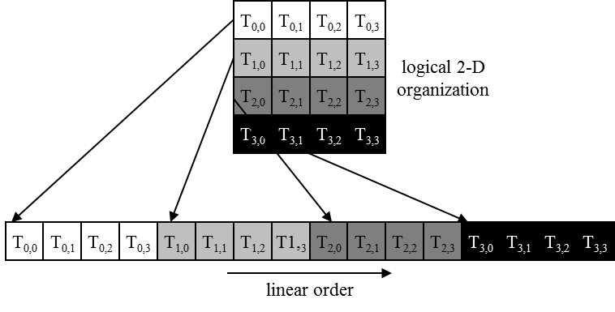
Warps in Multi-dimensional Thread Blocks
The thread blocks are first linearized into 1D in row major order
In x-dimension first, y-dimension next, and z-dimension last
Figure 6.1: Placing 2D threads into linear order

Slide 5
Blocks are partitioned after linearization
Linearized thread blocks are partitioned
Thread indices within a warp are consecutive and increasing
Warp 0 starts with Thread 0
Partitioning scheme is consistent across devices
Thus you can use this knowledge in control flow
However, the exact size of warps may change from generation to generation
DO NOT rely on any ordering within or between warps
If there are any dependencies between threads, you must __syncthreads() to get correct results (more later).

Slide 6
SMs are SIMD Processors
Control unit for instruction fetch, decode, and control is shared among multiple processing units
Control overhead is minimized (Module 1)
Memory
I/O
Processing Unit
Shared Memory
Register
File
ALU
Control Unit
PC
IR
Processor (SM)
Notes:
Insert von-neumann schematic here

Slide 7
SIMD Execution Among Threads in a Warp
All threads in a warp must execute the same instruction at any point in time
This works efficiently if all threads follow the same control flow path
All if-then-else statements make the same decision
All loops iterate the same number of times
Notes:
WARP_SIZE

Slide 8
Control Divergence
Control divergence occurs when threads in a warp take different control flow paths by making different control decisions
Some take the then-path and others take the else-path of an if-statement
Some threads take different number of loop iterations than others
The execution of threads taking different paths are serialized in current GPUs
The control paths taken by the threads in a warp are traversed one at a time until there is no more.
During the execution of each path, all threads taking that path will be executed in parallel
The number of different paths can be large when considering nested control flow statements
Notes:
WARP_SIZE

Slide 9
Control Divergence Examples
Divergence can arise when branch or loop condition is a function of thread indices
Example kernel statement with divergence:
if (threadIdx.x > 2) { }
This creates two different control paths for threads in a block
Decision granularity < warp size; threads 0, 1 and 2 follow different path than the rest of the threads in the first warp
Example without divergence:
If (blockIdx.x > 2) { }
Decision granularity is a multiple of blocks size; all threads in any given warp follow the same path

Slide 10
Example: Vector Addition Kernel
// Compute vector sum C = A + B
// Each thread performs one pair-wise addition
__global__
void vecAddKernel(float* A, float* B, float* C, int n)
{
int i = threadIdx.x + blockDim.x * blockIdx.x;
if(i<n) C[i] = A[i] + B[i];
}
Device Code

Slide 11
Analysis for vector size of 1,000 elements
Assume that block size is 256 threads
8 warps in each block
All threads in Blocks 0, 1, and 2 are within valid range
i values from 0 to 767
There are 24 warps in these three blocks, none will have control divergence
Most warps in Block 3 will not control divergence
Threads in the warps 0-6 are all within valid range, thus no control divergence
One warp in Block 3 will have control divergence
Threads with i values 992-999 will all be within valid range
Threads with i values of 1000-1023 will be outside valid range
Effect of serialization on control divergence will be small
1 out of 32 warps has control divergence
The impact on performance will likely be less than 3%

Slide 12
The GPU Teaching Kit is licensed by NVIDIA and the University of Illinois under the Creative Commons Attribution-NonCommercial 4.0 International License.

